Slide 1
Analysis of RR Lyrae Overdensities
Authors: Alec Hewitt, Jonathan Barnes
Salt Lake Community College
Abstract
Data concerning the RR Lyrae provided by G. Torrealba et. al., are reexamined and some of their claims are analyzed and reevaluated. RR Lyrae are variable stars whose brightness pulsates over time. Over densities of RR Lyrae have been claimed to originate outside of our galaxy and another approach is used to confirm this claim. The metallicity of certain over densities are analyzed to determine and confirm the origin of the RR Lyrae over densities.

Slide 2
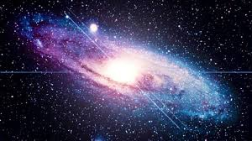
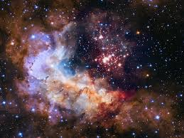
The Beginning
- After 380,000 years hydrogen and helium
- After ~1.6 million years stars formed
- Soon galaxies formed
bigthink.org
spacetelescope.org

Slide 3
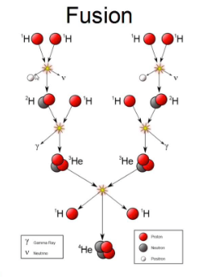
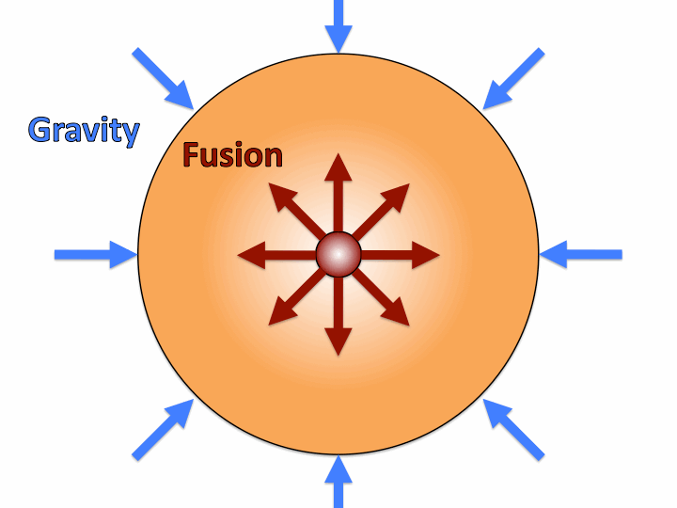
Fusion
The force of gravity causes atoms to fuse
The energy released counteracts the force of gravity
This process keeps the star in equilibrium
wikipedia.org
large.stanford.edu

Slide 4
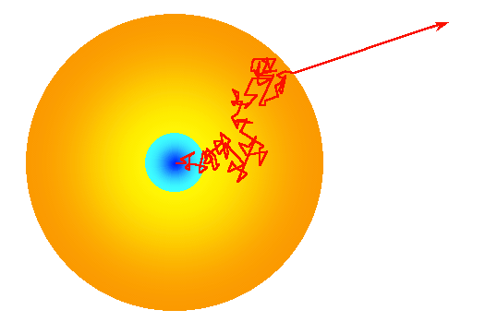
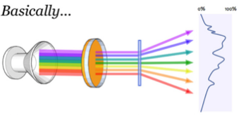
Spectrometry
Photon loses energy during collisions
Photon eventually gets absorbed and reemitted
Spectrometry uniquely identifies the element that emitted the photon
quora.com
publiclab.org

Slide 5
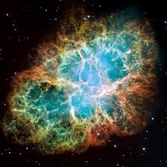
Supernovae
Fusing into iron doesn't release energy
After iron forms the star undergoes a supernova explosion
Most of its mass is thrown outward
Cloud of matter cools to create new stars
Newer generation contains more metal
en.wikipedia.org

Slide 6
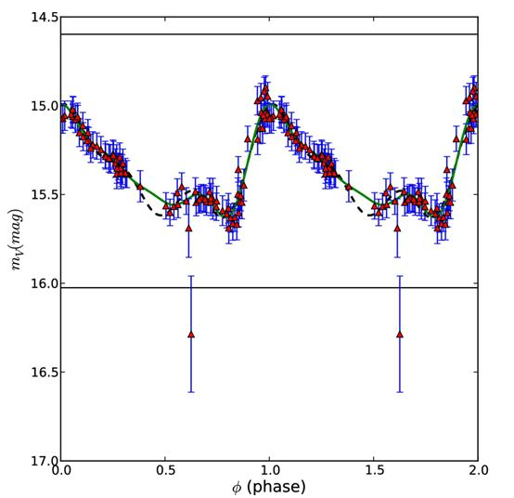
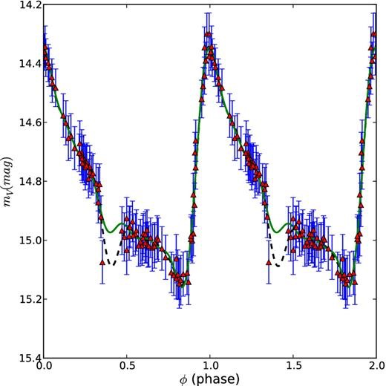
Photometry/Light Curves
Light curves are generated by photometry
Astronomers use light curves to obtain spectrum of the star

Slide 7
Metallicity
Astronomers consider any element other than hydrogen and helium as being metals
Metallicity can be visualized as the number of iron atoms over the number of hydrogen or helium atoms

Slide 8
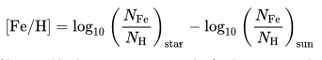
Comparing Metallicities with our Sun
We want to compare the metallicity of our sun to RR Lyrae
Parts of our galaxy should contain the same metallicity
Parts that have different metallicities may have originated from another galaxy entirely
en.wikipedia.org

Slide 9
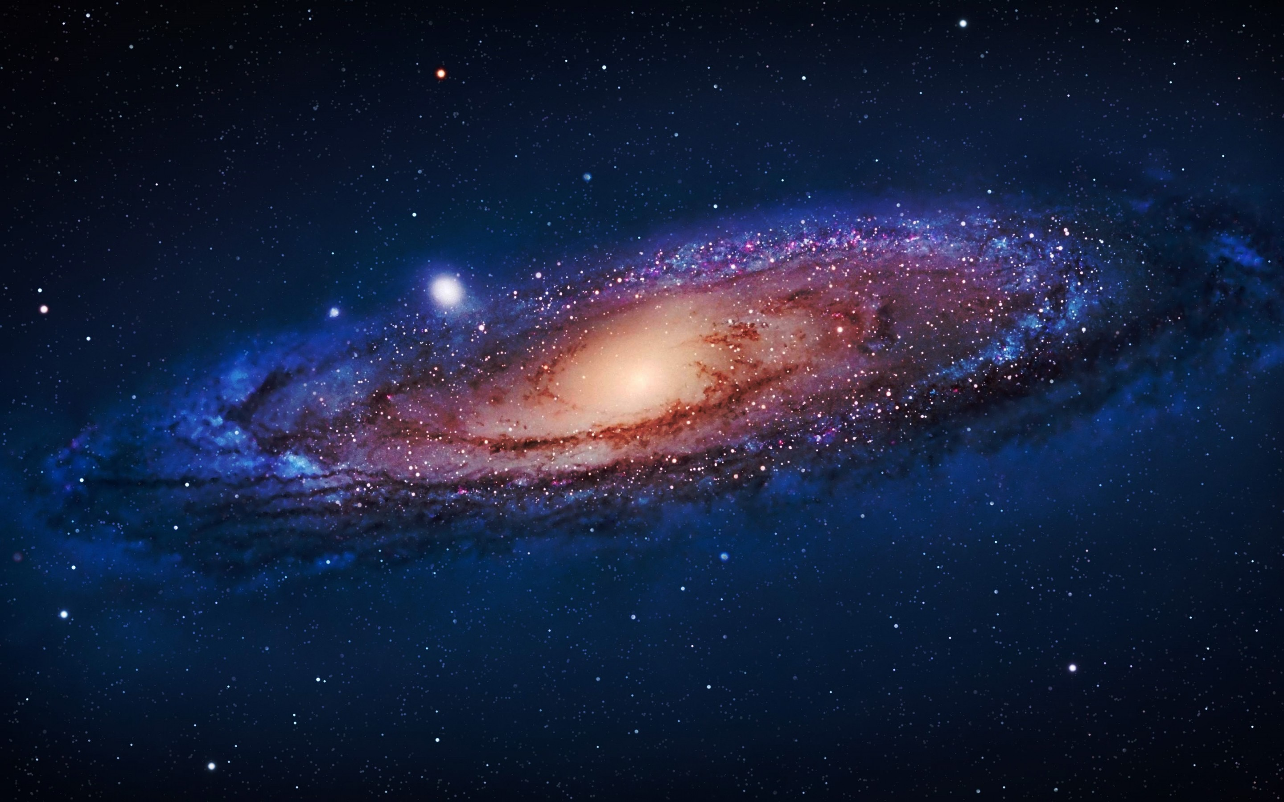

Terminology
|Z| (height)
galactic center
galactic plane
Rxy (radial distance)
wallpaperswide.com

Slide 10
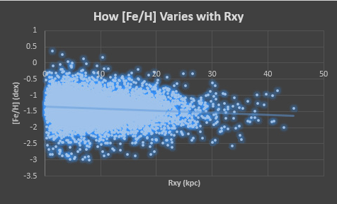
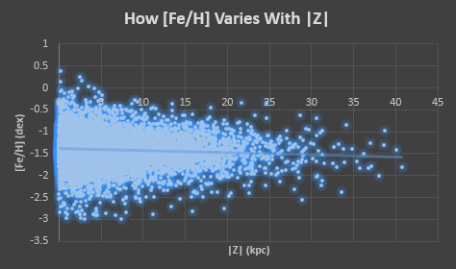
Confirming Claims
Metallicity decreases as radial distance increases
Metallicity decreases as height from galactic plane increases
Using their data we created plots
Our plots agree

Slide 11
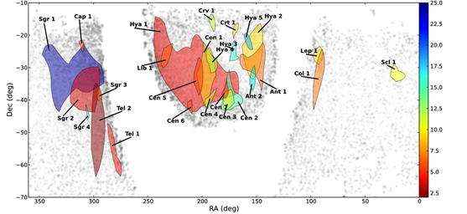
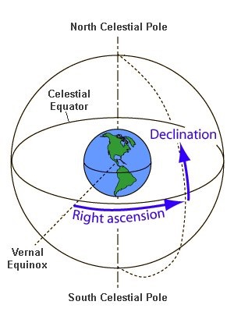
Overly Dense Regions
Regions are empty due to the stars being overcrowded
Colored regions represent areas that are overly dense with stars
Torrealba claims these areas are overly dense because they came from other galaxies
schoolsobservatory.org

Slide 12
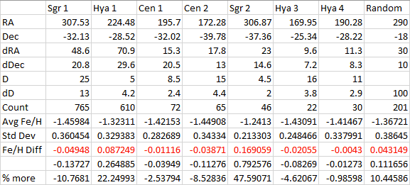
Comparing Metallicities

Slide 13
Works Cited/Acknoledgments
Jonathan Barnes
Monthly Notices of the Royal Astronomical Society, Volume 446, Issue 3, 21 January 2015, Pages 2251–2266, https://doi.org/10.1093/mnras/stu2274
“CERN Accelerating Science.” The Early Universe | CERN, home.cern/about/physics/early-universe.
“WHY DOES THE SUN SHINE?” Lecture 2: Why Does the Sun Shine?, www.astronomy.ohio-state.edu/~ryden/ast162_1/notes2.html.

